Slide 1
RESTFul API's do 0 à Nuvem Com ASP.NET Core 2.0 e Docker

Slide 2





Seção 01: Fundamentos Teóricos Do REST
Leandro Costa
http://www.erudio.com.br/
https://bit.ly/2IkHwoa
http://www.semeru.com.br/
https://hub.docker.com/u/leandrocgsi/
https://github.com/leandrocgsi/RestWithASP-NETUdemy

Slide 3
Seção 02: Fundamentos Teóricos Do REST
Leandro Costa
http://www.erudio.com.br/
https://bit.ly/2IkHwoa
http://www.semeru.com.br/
https://hub.docker.com/u/leandrocgsi/
https://github.com/leandrocgsi/RestWithASP-NETUdemy

Slide 4
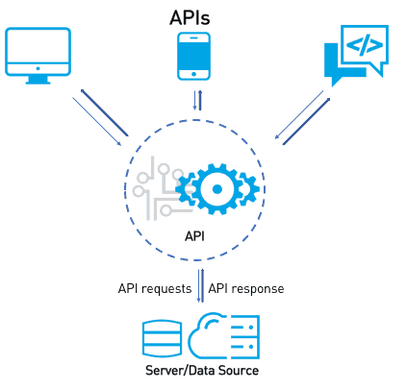
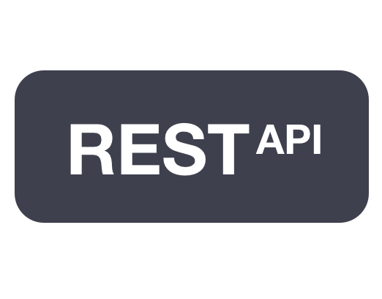




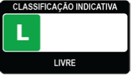

Slide 5
Seção 03: Configuração Do Ambiente No Windows
Leandro Costa
http://www.erudio.com.br/
https://bit.ly/2IkHwoa
http://www.semeru.com.br/
https://hub.docker.com/u/leandrocgsi/
https://github.com/leandrocgsi/RestWithASP-NETUdemy

Slide 6








Slide 7
Seção 04: Configuração Do Ambiente No Linux
Leandro Costa
http://www.erudio.com.br/
https://bit.ly/2IkHwoa
http://www.semeru.com.br/
https://hub.docker.com/u/leandrocgsi/
https://github.com/leandrocgsi/RestWithASP-NETUdemy

Slide 8





Slide 9
Seção 05: Primeiros Passos
Leandro Costa
http://www.erudio.com.br/
https://bit.ly/2IkHwoa
http://www.semeru.com.br/
https://hub.docker.com/u/leandrocgsi/
https://github.com/leandrocgsi/RestWithASP-NETUdemy

Slide 10




Slide 11
Seção 06: Implementando Uma Calculadora
Leandro Costa
http://www.erudio.com.br/
https://bit.ly/2IkHwoa
http://www.semeru.com.br/
https://hub.docker.com/u/leandrocgsi/
https://github.com/leandrocgsi/RestWithASP-NETUdemy

Slide 12


Slide 13
Seção 07: Aprendendo Os Quatro Verbos Principais
Leandro Costa
http://www.erudio.com.br/
https://bit.ly/2IkHwoa
http://www.semeru.com.br/
https://hub.docker.com/u/leandrocgsi/
https://github.com/leandrocgsi/RestWithASP-NETUdemy

Slide 14
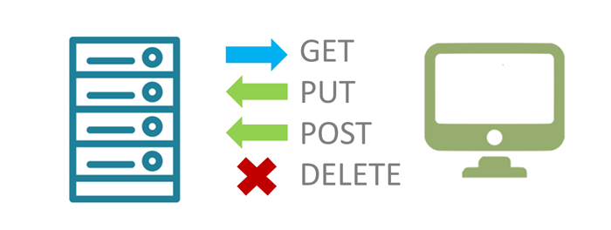

Slide 15
Seção 08: Integrando A Aplicação Ao Banco De Dados
Leandro Costa
http://www.erudio.com.br/
https://bit.ly/2IkHwoa
http://www.semeru.com.br/
https://hub.docker.com/u/leandrocgsi/
https://github.com/leandrocgsi/RestWithASP-NETUdemy

Slide 16

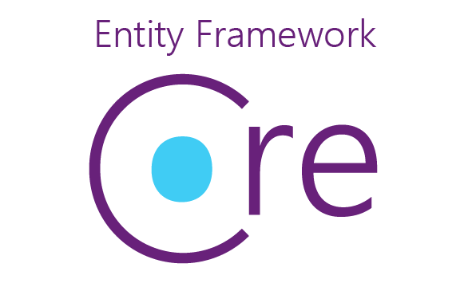



Slide 17
Seção 09: Versionamento Da Nossa API
Leandro Costa
http://www.erudio.com.br/
https://bit.ly/2IkHwoa
http://www.semeru.com.br/
https://hub.docker.com/u/leandrocgsi/
https://github.com/leandrocgsi/RestWithASP-NETUdemy

Slide 18
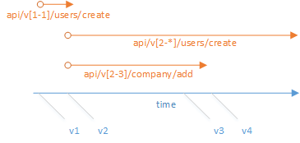

Slide 19
Seção 10: Adotando Uma Arquitetura Em Camadas
Leandro Costa
http://www.erudio.com.br/
https://bit.ly/2IkHwoa
http://www.semeru.com.br/
https://hub.docker.com/u/leandrocgsi/
https://github.com/leandrocgsi/RestWithASP-NETUdemy

Slide 20
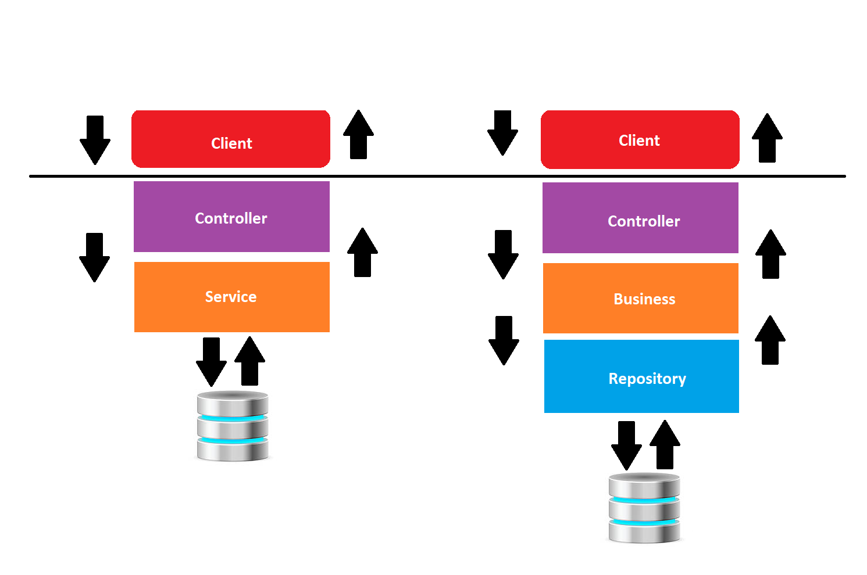

Slide 21
Seção 11: Migrations
Leandro Costa
http://www.erudio.com.br/
https://bit.ly/2IkHwoa
http://www.semeru.com.br/
https://hub.docker.com/u/leandrocgsi/
https://github.com/leandrocgsi/RestWithASP-NETUdemy

Slide 22
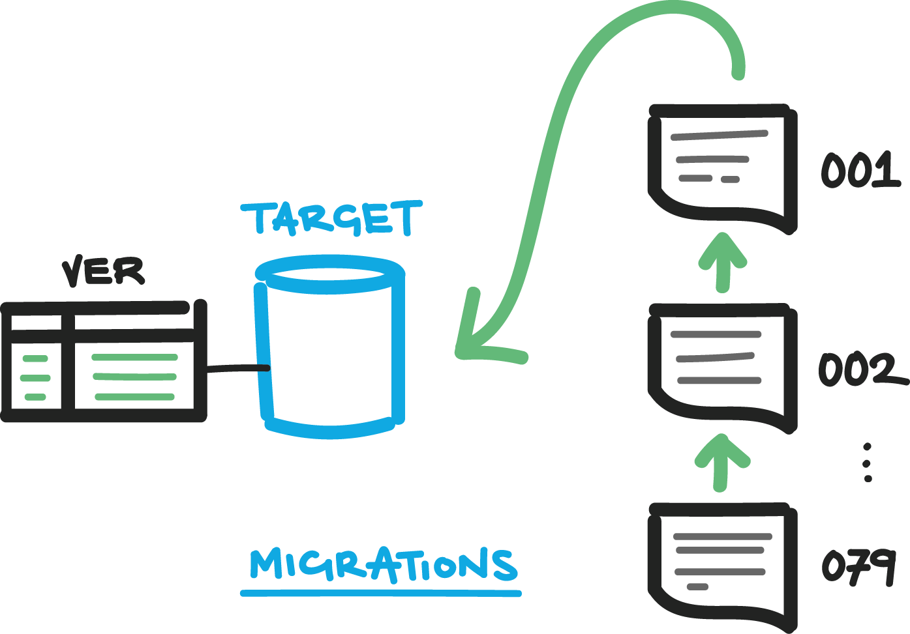


Slide 23
Seção 12: Padrão De Projeto Generic Repository
Leandro Costa
http://www.erudio.com.br/
https://bit.ly/2IkHwoa
http://www.semeru.com.br/
https://hub.docker.com/u/leandrocgsi/
https://github.com/leandrocgsi/RestWithASP-NETUdemy

Slide 24
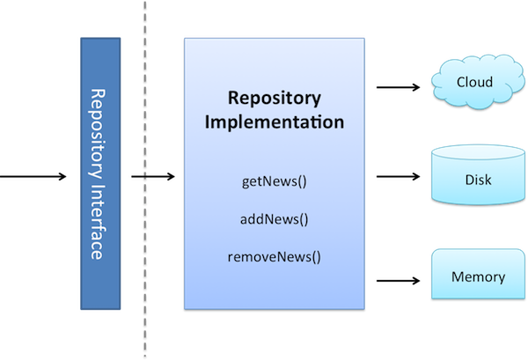

Slide 25
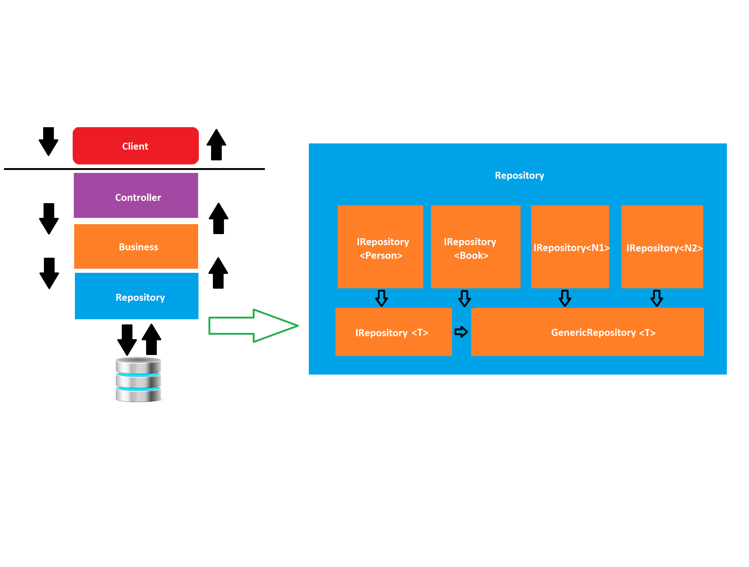

Slide 26
Seção 13: Padrão De Projeto Value Object (VO)
Leandro Costa
http://www.erudio.com.br/
https://bit.ly/2IkHwoa
http://www.semeru.com.br/
https://hub.docker.com/u/leandrocgsi/
https://github.com/leandrocgsi/RestWithASP-NETUdemy

Slide 27
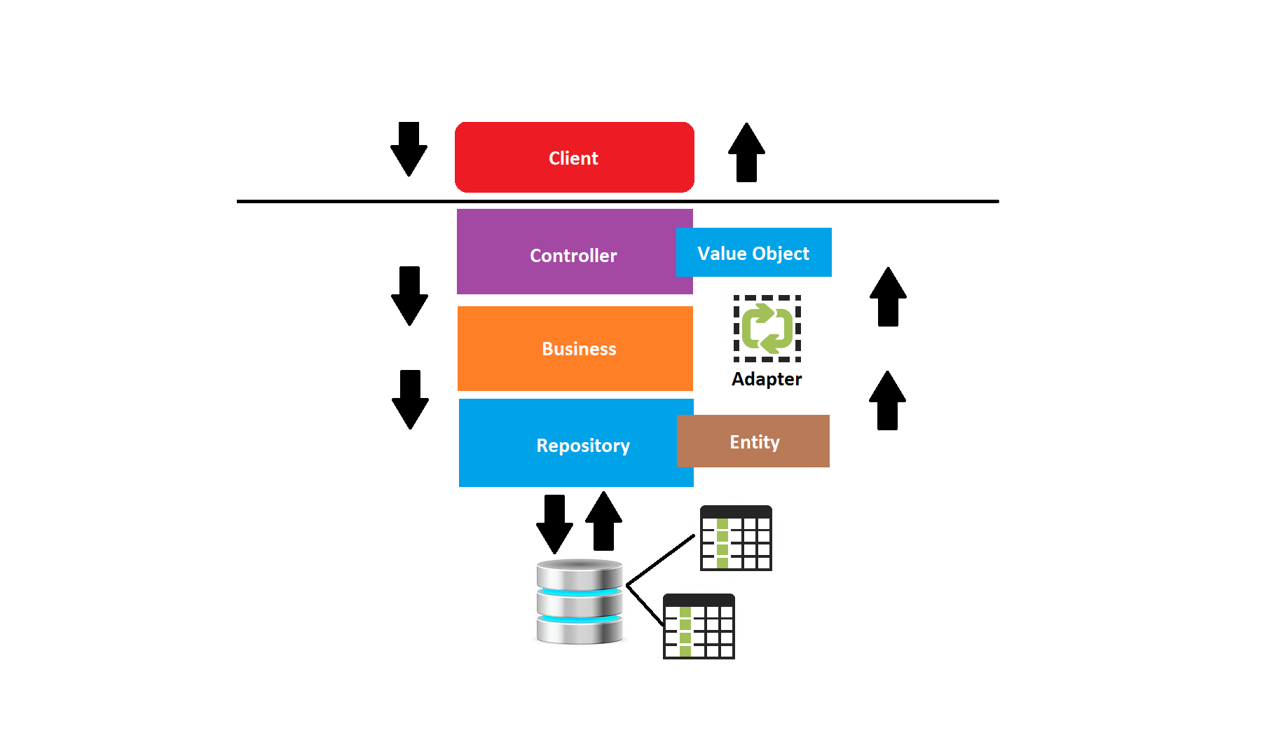

Slide 28
Seção 14: Data Contract
Leandro Costa
http://www.erudio.com.br/
https://bit.ly/2IkHwoa
http://www.semeru.com.br/
https://hub.docker.com/u/leandrocgsi/
https://github.com/leandrocgsi/RestWithASP-NETUdemy

Slide 29
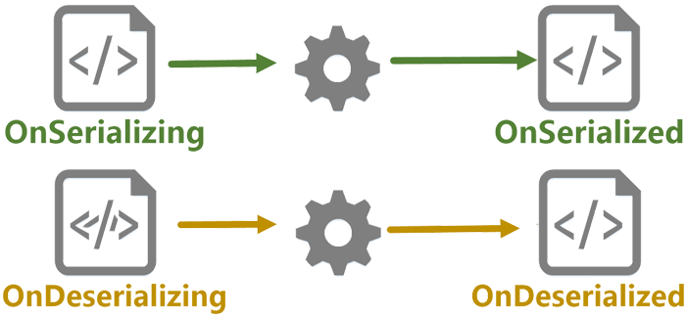

Slide 30
Seção 15: Content Negociation
Leandro Costa
http://www.erudio.com.br/
https://bit.ly/2IkHwoa
http://www.semeru.com.br/
https://hub.docker.com/u/leandrocgsi/
https://github.com/leandrocgsi/RestWithASP-NETUdemy

Slide 31

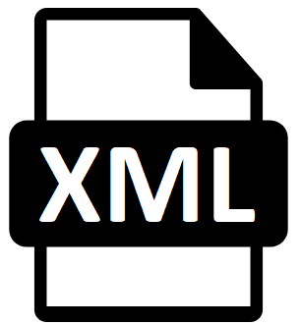



Slide 32
Seção 16: HATEOAS
Leandro Costa
http://www.erudio.com.br/
https://bit.ly/2IkHwoa
http://www.semeru.com.br/
https://hub.docker.com/u/leandrocgsi/
https://github.com/leandrocgsi/RestWithASP-NETUdemy

Slide 33


Slide 34
Seção 17: Swagger
Leandro Costa
http://www.erudio.com.br/
https://bit.ly/2IkHwoa
http://www.semeru.com.br/
https://hub.docker.com/u/leandrocgsi/
https://github.com/leandrocgsi/RestWithASP-NETUdemy

Slide 35



Slide 36
Seção 18: Autenticação
Leandro Costa
http://www.erudio.com.br/
https://bit.ly/2IkHwoa
http://www.semeru.com.br/
https://hub.docker.com/u/leandrocgsi/
https://github.com/leandrocgsi/RestWithASP-NETUdemy

Slide 37


Slide 38
Seção 19: O Verbo PATH
Leandro Costa
http://www.erudio.com.br/
https://bit.ly/2IkHwoa
http://www.semeru.com.br/
https://hub.docker.com/u/leandrocgsi/
https://github.com/leandrocgsi/RestWithASP-NETUdemy

Slide 39
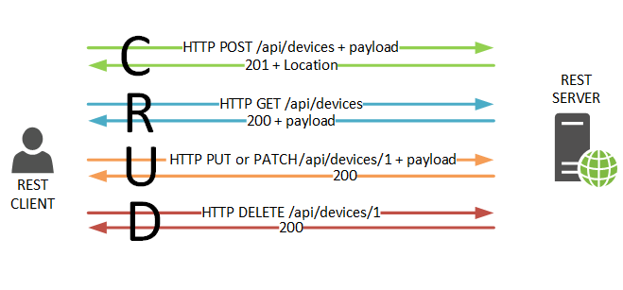

Slide 40
Seção 20: Query Params E Busca Paginada
Leandro Costa
http://www.erudio.com.br/
https://bit.ly/2IkHwoa
http://www.semeru.com.br/
https://hub.docker.com/u/leandrocgsi/
https://github.com/leandrocgsi/RestWithASP-NETUdemy

Slide 41
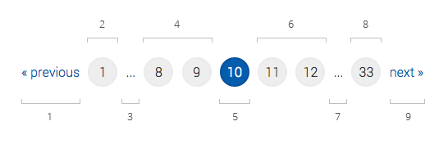

Slide 42
Seção 21: Trabalhando Com Arquivos
Leandro Costa
http://www.erudio.com.br/
https://bit.ly/2IkHwoa
http://www.semeru.com.br/
https://hub.docker.com/u/leandrocgsi/
https://github.com/leandrocgsi/RestWithASP-NETUdemy

Slide 43
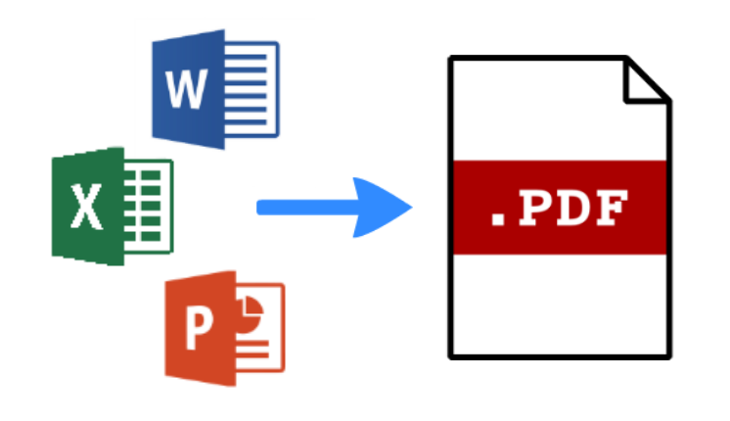

Slide 44
Seção 22: Adicionando Suporte Ao Docker
Leandro Costa
http://www.erudio.com.br/
https://bit.ly/2IkHwoa
http://www.semeru.com.br/
https://hub.docker.com/u/leandrocgsi/
https://github.com/leandrocgsi/RestWithASP-NETUdemy

Slide 45

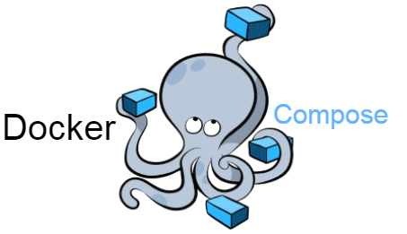


Slide 46
Seção 23: Deploy Na Azure
Leandro Costa
http://www.erudio.com.br/
https://bit.ly/2IkHwoa
http://www.semeru.com.br/
https://hub.docker.com/u/leandrocgsi/
https://github.com/leandrocgsi/RestWithASP-NETUdemy

Slide 47
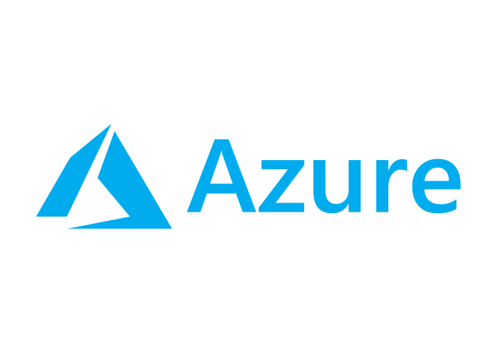

Slide 48
O Padrão de Projetos Repository

Slide 49
Generic Repository

Slide 50
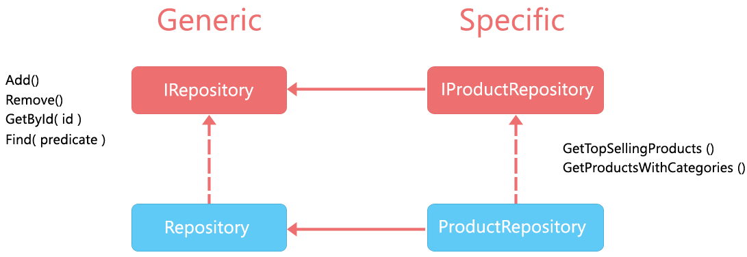

Slide 51
Referências
http://www.dotnetcurry.com/aspnet-mvc/1155/aspnet-mvc-repository-pattern-perform-database-operations
https://www.c-sharpcorner.com/UploadFile/8a67c0/repository-pattern-and-generic-repository-pattern/
http://www.tugberkugurlu.com/archive/generic-repository-pattern-entity-framework-asp-net-mvc-and-unit-testing-triangle
https://www.codeproject.com/Articles/814768/CRUD-Operations-Using-the-Generic-Repository-Patte
http://hannesdorfmann.com/android/evolution-of-the-repository-pattern

Slide 52
Referências
https://martinfowler.com/bliki/PresentationDomainDataLayering.html
https://msdn.microsoft.com/en-us/library/ee658109.aspx
https://msdn.microsoft.com/en-us/library/ff648105.aspx
https://en.wikipedia.org/wiki/Multitier_architecture
https://www.linkedin.com/learning/practical-application-architecture-with-entity-framework-core/multi-layer-applications

Slide 53
Referências
https://martinfowler.com/bliki/ValueObject.html
https://www.codeadventure.com/blog/why-you-should-use-value-objects
https://www.devmedia.com.br/diferenca-entre-os-patterns-po-pojo-bo-dto-e-vo/28162
https://imasters.com.br/artigo/7293/linguagens/padroes-de-projeto-value-object?trace=1519021197
[Generic Repository and Unit of Work Pattern, Entity Framework, Unit Testing, Autofac IoC Container and ASP.NET MVC](https://techbrij.com/generic-repository-unit-of-work-entity-framework-unit-testing-asp-net-mvc)
[HATEOAS](https://shatzisblog.wordpress.com/2017/09/01/generating-hypermedia-links-for-an-asp-net-core-web-api/)
[Pragmatic REST: APIs without hypermedia and HATEOAS](http://www.ben-morris.com/pragmatic-rest-apis-without-hypermedia-and-hateoas/)

Slide 54
Referências
https://msdn.microsoft.com/en-us/library/ff384251.aspx
https://nordicapis.com/introduction-to-api-versioning-best-practices/
http://www.patrickniezen.com/2016/2/11/api-versioning-with-mvc-6
https://www.troyhunt.com/your-api-versioning-is-wrong-which-is/
https://www.youtube.com/watch?v=55oIJuMUnDc

